Slide 1
Sentiment analysis
Derek Sun 2230026141
Camille Wu 2230026168
Kristoff Wang 2230026161

Slide 2
Hard Road
What we mainly focus: Irony
Why we focus: Help people better understand each other

Slide 3

Original thinking
Methodology Attempts
7 Emotions
Data
Text Sentimental
Analysis
Sarcasm
TextCNN
Label
Old-schooled
Model
BERT
What we mainly focus: Irony
Why we focus: Help people better understand each other

Slide 4
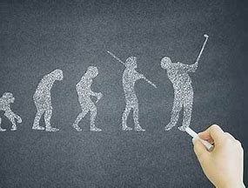

Original thinking
Thinking Road
Machine Recognize Texts
Nature Inspiration
Machines Inspirations
Human Learning
Other
Frequency
Score
Experience
behavior
Network
Dictionary
count

Slide 5
Original thinking
Score
Accumulation
Methodology Attempts
Semantics
7 Emotions
Data
Text Sentimental
Analysis
Sarcasm
TextCNN
Label
Old-schooled
Model
BERT
State-of-the-ART
Lexicon
BLOOM
Nezha(Huawei)
GPT API

Slide 6
02
Model Implementation
Base TextCNN
BERT
BLOOM

Slide 7
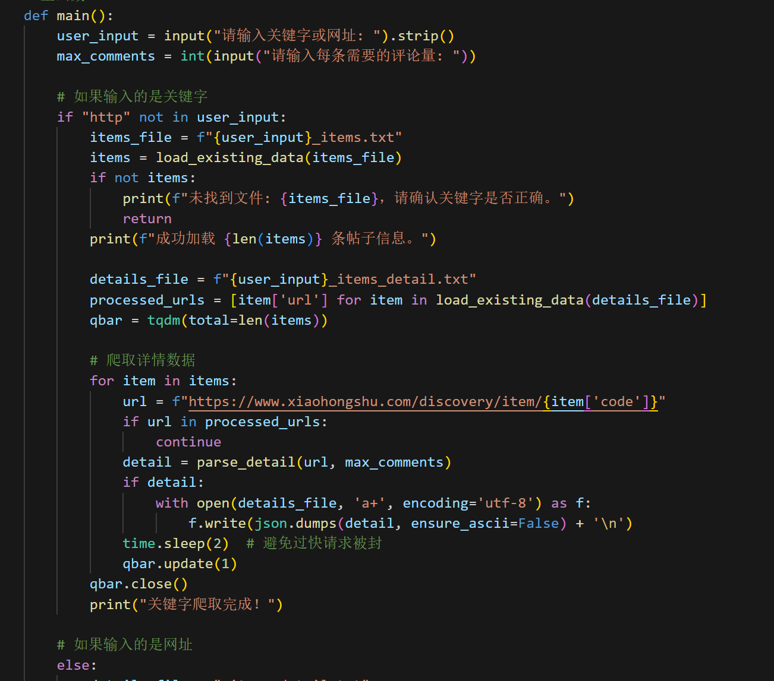
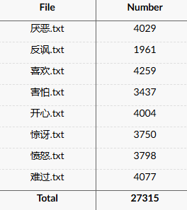
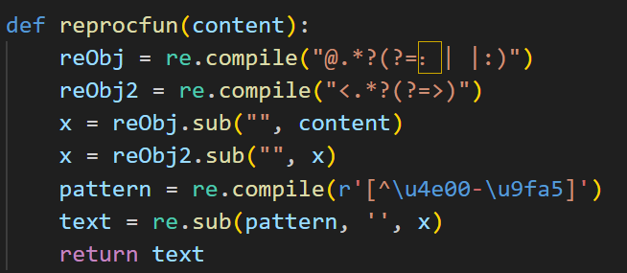
Data Preparation
02. Cleaning
01. Xiaohongshu Crawler & Weibo Datasets(Training set and Test set)

Slide 8


Base TextCNN interface & Visualization
01. Model training
02. Result Confidence and Visualization

Slide 9

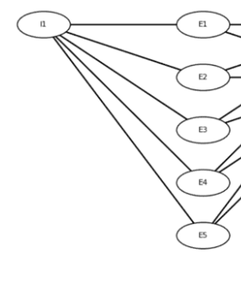
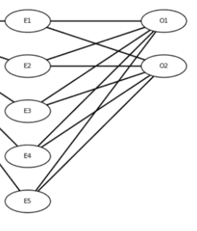
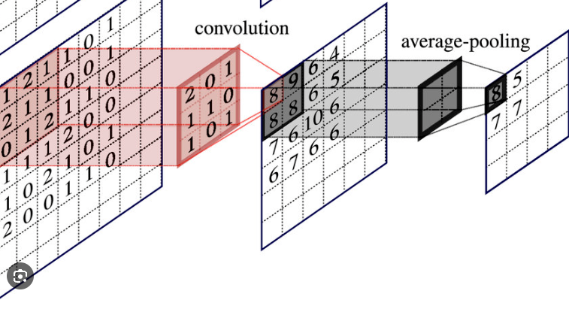


Model Construction : TextCNN
Structure: Convolutional Neural Networks (CNN) for text classification.
Embedding Layer
Layer
Convolutional and Pooling Layers
Fully Connected Layer

Slide 10
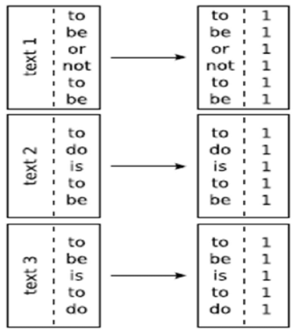
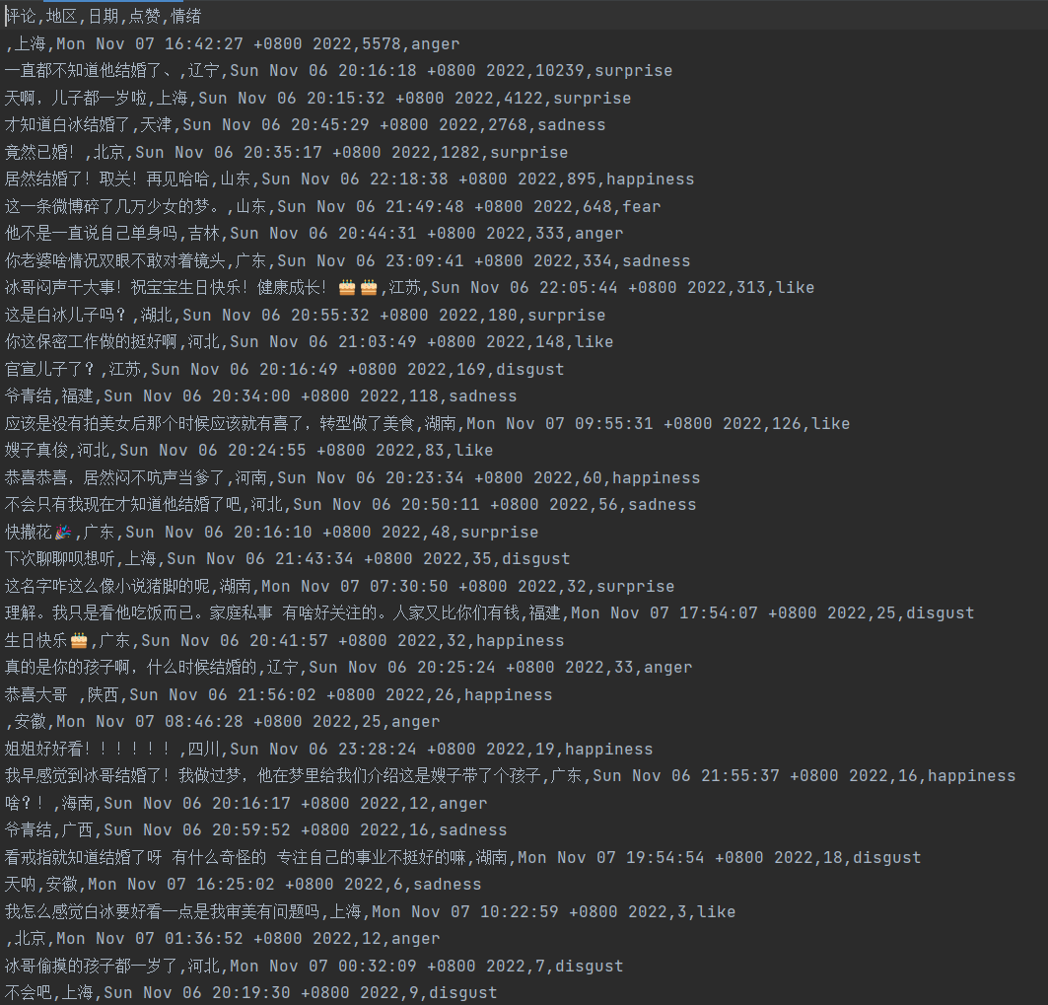

Model Construction : Dataset Modification
Word Frequency Calculation
Build Vocabulary
UNK
Special Tokens
PAD
Tokenizer
Split Dataset
Labels Setup
Training Set/ Test set
Custom Iterator

Slide 11

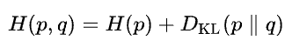
Model Construction : Training and Evaluation
Cross-entropy loss and Backpropagation
divergence of p from q
Classification report
Model Evaluation
Confusion matrix

Slide 12
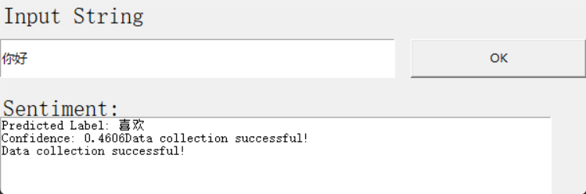
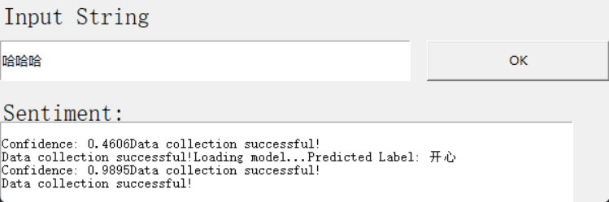
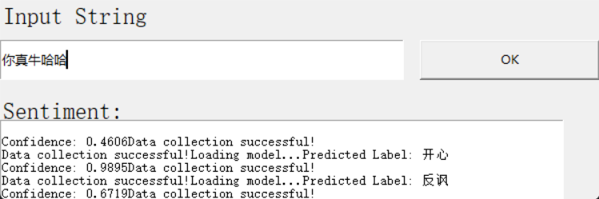
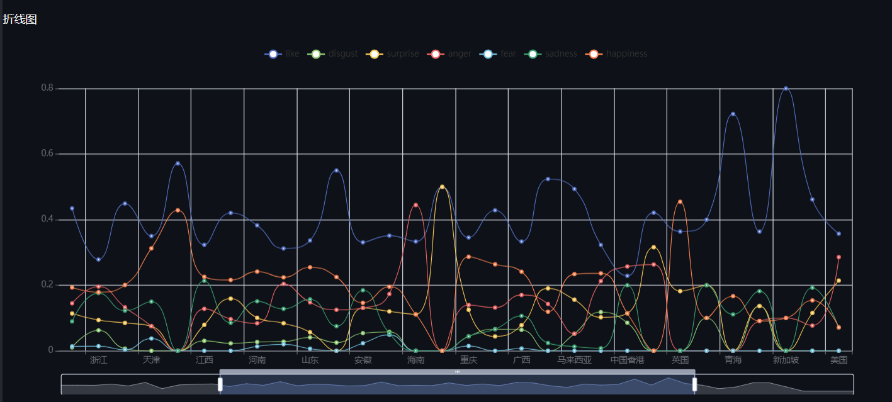
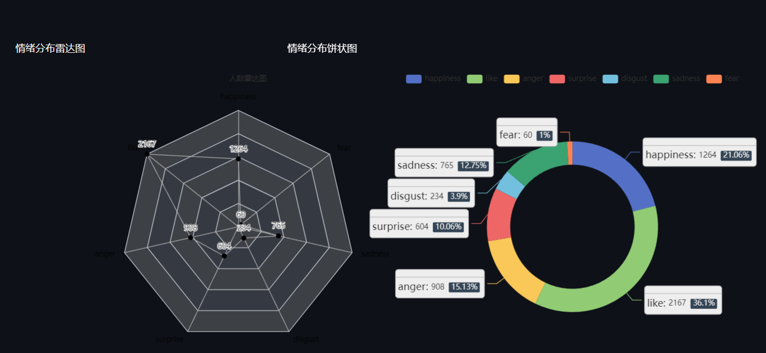
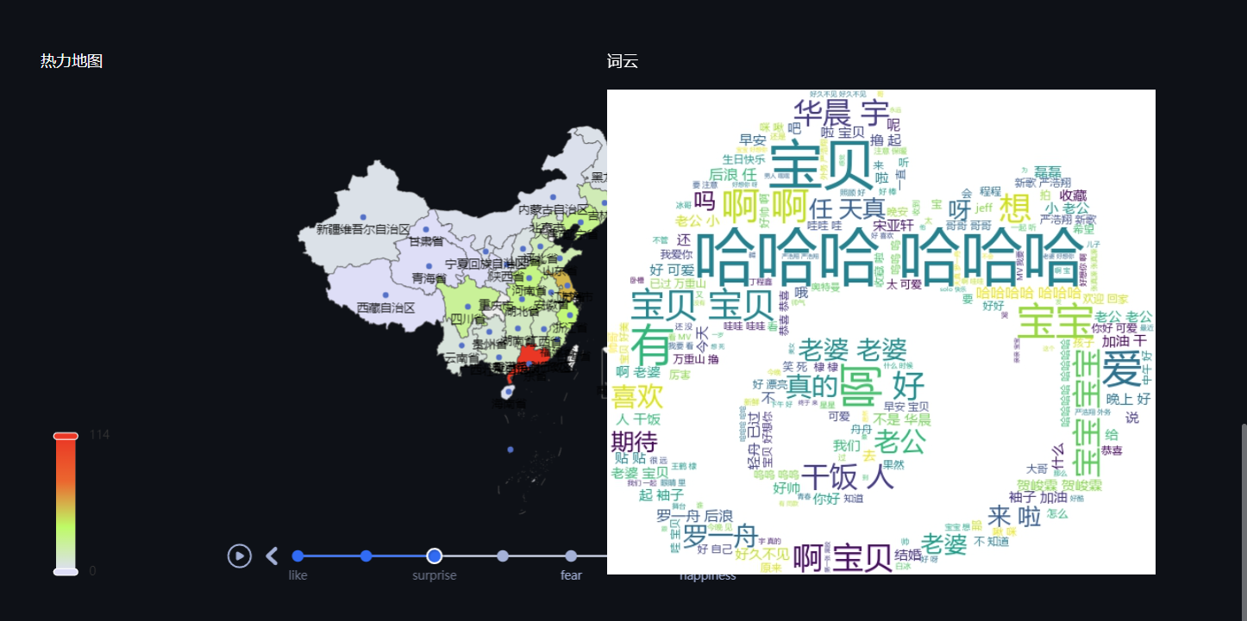
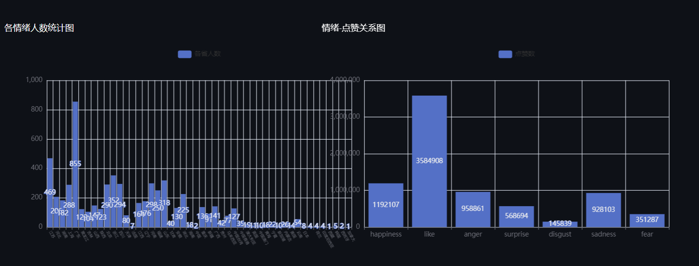
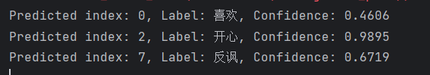
Result confidence and Visualization
GUI input service, visualization

Slide 13
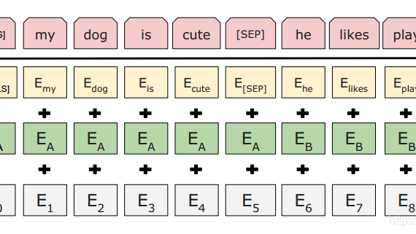
Sarcasm Detection of English Text with BERT

Slide 14
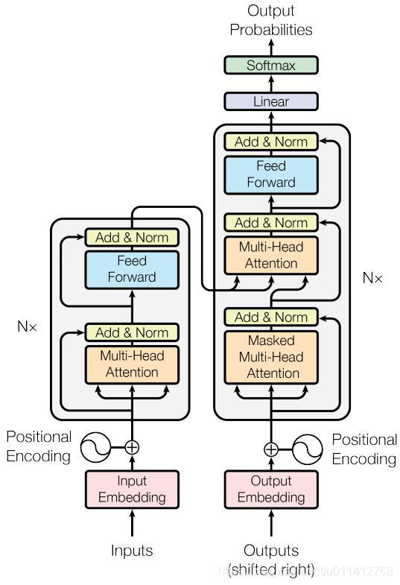
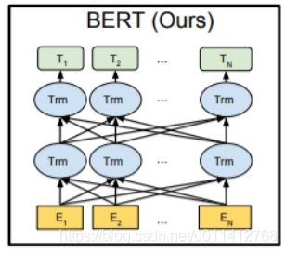
Notes:
Also transformers based model

Slide 15
The BERT model is fine-tuned using the Hugging Face library, where the text data is tokenized with BertTokenizer, and the model is adapted for sarcasm classification:
def fine_tune_bert(train_texts, train_labels, val_texts, val_labels, max_length=30, batch_size=16, epochs=3):
tokenizer = BertTokenizer.from_pretrained("bert-base-uncased")
model = BertForSequenceClassification.from_pretrained("bert-base-uncased", num_labels=2).to(device)
train_encodings = tokenizer(train_texts, truncation=True, padding=True, max_length=max_length, return_tensors="pt")
train_dataset = SarcasmDataset(train_encodings['input_ids'], train_labels)
optimizer = optim.AdamW(model.parameters(), lr=5e-5)
for epoch in range(epochs):
model.train()
for data, labels in train_loader:
data, labels = data.to(device), labels.to(device, dtype=torch.long)
outputs = model(input_ids=data, labels=labels)
loss = outputs.loss
optimizer.zero_grad()
loss.backward()
optimizer.step()
return model

Slide 16
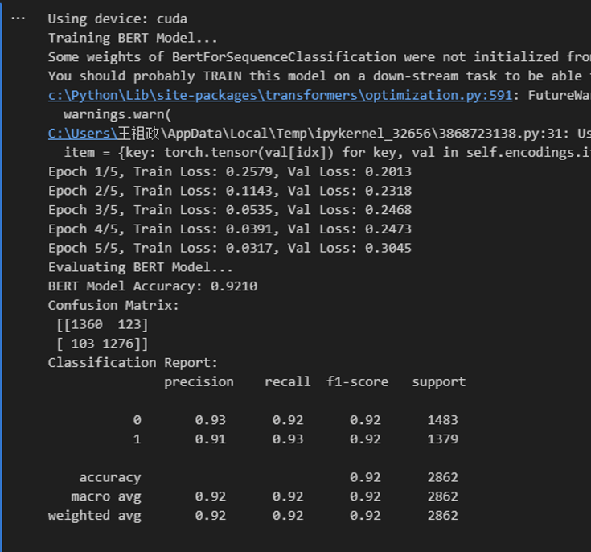

Slide 17

Sarcasm Detection By BLOOM-560M

Slide 18
Introduction
The BLOOM model
(BigScience Large Open-science Open-access Multilingual)
created and released in 2022
by the BigScience project
BLOOM was trained on text in 59 languages,
enabling it to understand and generate text in many languages.
It can perform tasks like text generation, translation, and classification.
Created with open access in mind, it’s a useful tool for researchers and various NLP tasks.

Slide 19
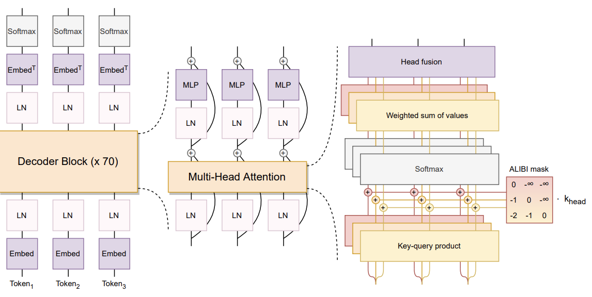
BLOOM framework
BigScience Large Open-science Open-access Mul-tilingual Language Model
The additional Layer Normalization (LN) after the embedding layer improves training stability. This decision is influenced by the use of bfloat16 during training, which is more stable than float16.
Notes:
Transformer based model

Slide 20
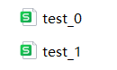
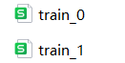
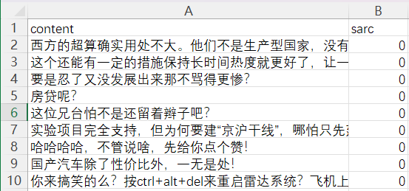
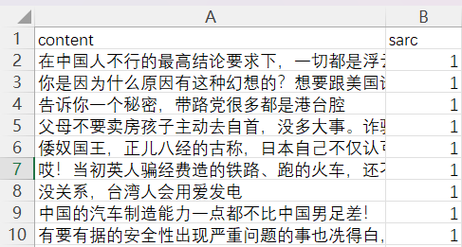
Implement process

Slide 21
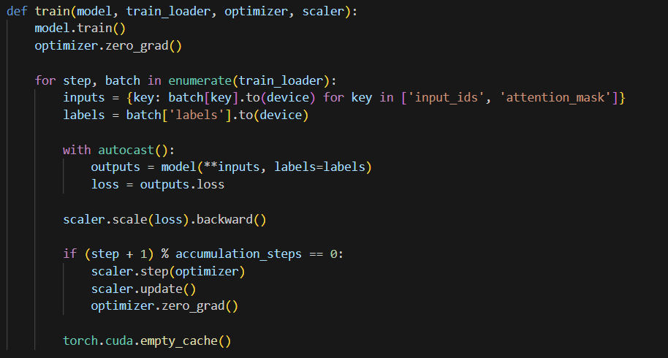
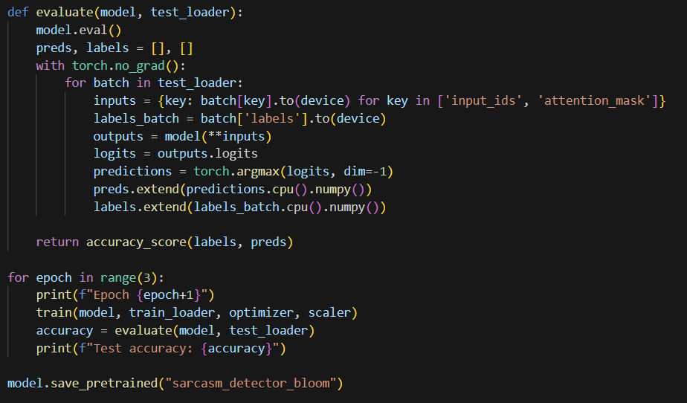

Slide 22
Validation accuracy after 3 epochs
70.1%
BLOOM-560M Accuracy (code output is in the report)

Slide 23
Incomplete Part
03
Sentiment Lexicon
ChatGPT API
Nezha from Huawei

Slide 24
01 Sentiment Lexicon
Based on semantics
1.Positive + Negative
看你长得文质彬彬的，怎么不会说人话；给我一张你的靓照，我回去辟邪用
2. Classic saying
你是孙悟空的师弟，沙悟净的师兄；我不是草船，你的贱用不着总往我这儿乱发！
🙂
Stereotypes age
Notes:
现在的反语在不停的进化，有一些“定式”在不断的更新，比如说：“你真厉害“，”你懂的真多“原本是一种夸奖，但由于现代人对于语义的变化，这句话也变成了一句反语。
同样的不同的年龄也会有很大的理解差异：当你在晚上的时候收到了一个🙂的emoji，假如发送对象是你的父母或者老师，这或许是一个encourage，但假如是你的女朋友，well，wish you have a good night.

Slide 25
02 ChatGPT API
1.can’t get consistent result.
2. can’t judge which prompt is better. (no evaluation)
03 Nezha from Huawei
Too big

Slide 26








# 2024 data mining project
THANKS FOR YOUR LISTENING!

Slide 27

# 2024 data mining project
Q&A Time

